Slide 1
Polymorphism

Slide 2
Objectives
Overloading and Overriding
Interface
Abstract class

Slide 3
Polymorphism
The dictionary definition of polymorphism refers to a principle in biology in which an organism or species can have many different forms or stages.
Polymorphism was perfected in object-oriented languages
Ability allows many versions of a method based on overloading and overriding methods techniques.

Slide 4
Polymorphism
Overloading: A class can have some methods which have the same name but their parameter types are different.
Overriding: A method in the father class can be overridden in its derived classes (body of a method can be replaced in derived classes).

Slide 5
Overloading
Overloading addresses variations in a function's signature.
Overloading allows binding of function calls with the same identifier but different argument types
The compiler binds the function call to the matching function definition .

Slide 6
Overloading
overloading with constructors public Rectangle(){…}
public Rectangle(int length, int width){… }
Overloading also extends to general methods. public void setValue(int len){ length= (len>0)?1:0; } public void setValue (int len, int wi){ length= (len>0)? 1: 0; width= (wi>0)? wi:0; }
Rectangle
# length: int # width: int
+ Rectangle(); + Rectangle(int, int) + setValue(int): void + setValue(int, int): void

Slide 7
Overriding
A subclass provides the specific implementation of the method that has been declared by one of its pare
Subclasses of a class can define their own unique behaviors and yet share some of the same functionality of the parent class.

Slide 8
Overriding
public class Rectangle{
…
@override
public String toString(){
return length+”@” +width;
}
}
public class Box extends Rectangle{
…
@override
public String toString(){
return super.toString()+”@”+ height;
}
}
Rectangle
# length: int # width: int
+ Rectangle(); + Rectangle(int, int) + setValue(int ):void + setValue(int ,int ):void + toString(): String
Box
height: int
+ Box(); + Box(int, int, int) + toString(): String + set(int, int, int ): void

Slide 9
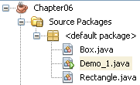
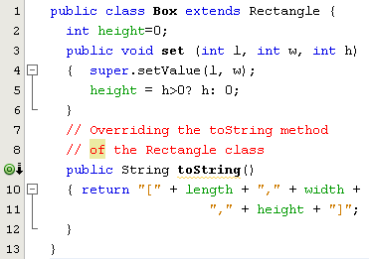
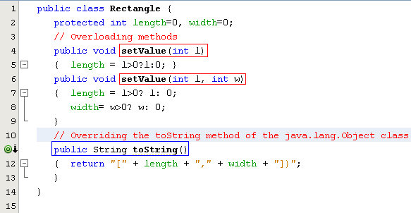

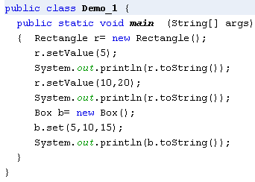
Overriding Inherited Methods
Overridden method: An inherited method is re-written
Overloaded methods: Methods have the same name but their parameters are different in a class

Slide 10
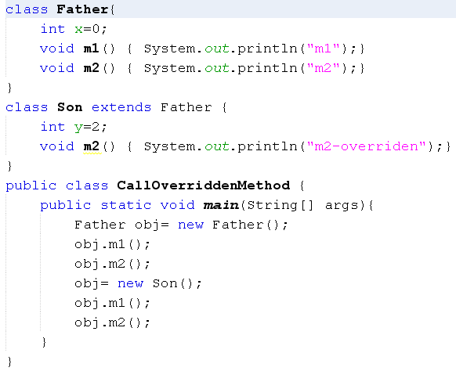
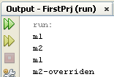
How Can Overridden Method be Determined?

Slide 11
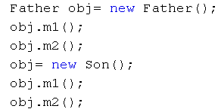
How Can Overridden Methods be Determined?
Son(declaration)
int y=2
Method Table
(m1, 600)
(m2, 800)
dynamic binding: based on the object's dynamic type. The method call is bonded to the method body at runtime.
800
m2()
700
Father(declaration)
int x=0
Method Table
(m1, 600)
(m2, 650)
Class: 700
Class: 500
y=2
x=0
x=0
650
m2()
600
m1()
obj: 8000
obj: 9000
500
obj.m1();
obj.m2();
obj.m1();
obj.m2();
Classes are loaded to static heap

Slide 12
Interface
An interface is a reference type, similar to a class, that can contain only constants, initialized fields, static methods, prototypes (abstract methods), default methods, and nested types.
It will be the core of some classes
Interfaces cannot be instantiated because they have no-body methods.
Interfaces can only be implemented by classes or extended by other interfaces.

Slide 13
WHY AND WHEN TO USE INTERFACES?
Objects define their interaction with the outside world through the methods that they expose
Java does not support "multiple inheritance" (a class can only inherit from one superclass). However, it can be achieved with interfaces, because the class can implement multiple interfaces

Slide 14
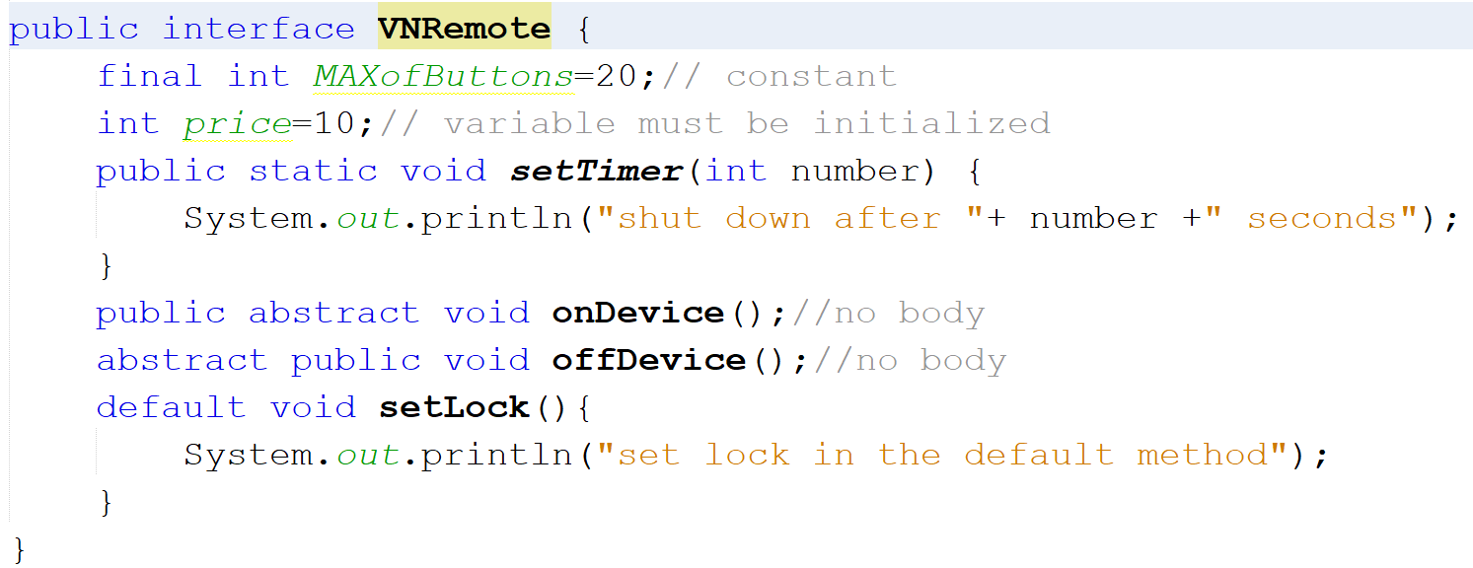
Example: how to create an interface

Slide 15
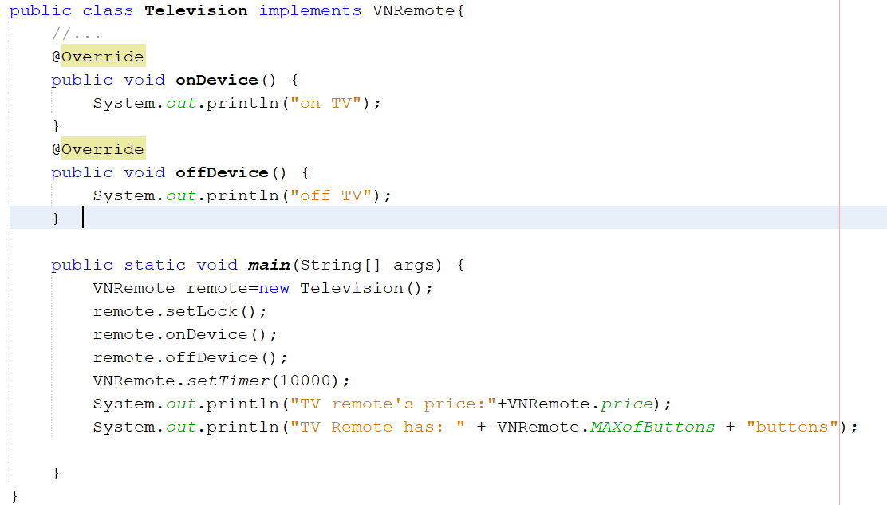
Example:implement an interface
Output:
set lock in the default method
on TV
off TV
shut down after 10000 seconds
TV remote's price:10
TV Remote has: 20buttons

Slide 16
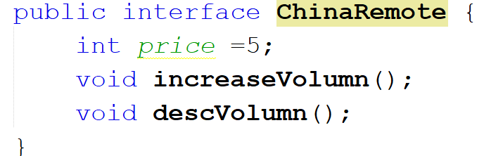
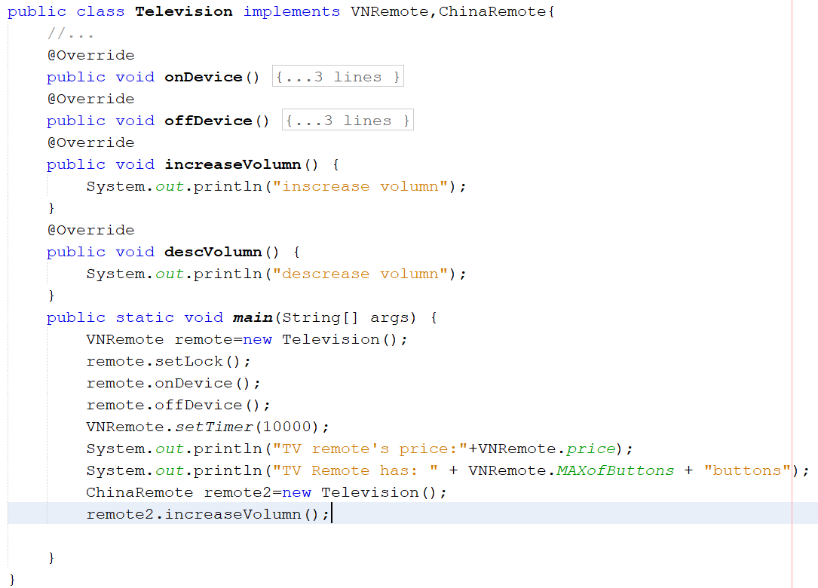
Example: multiple interfaces
Output:
set lock in the default method
on TV
off TV
shut down after 10000 seconds
TV remote's price:10
TV Remote has: 20buttons
increase volumn

Slide 17
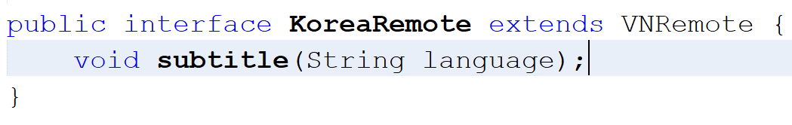
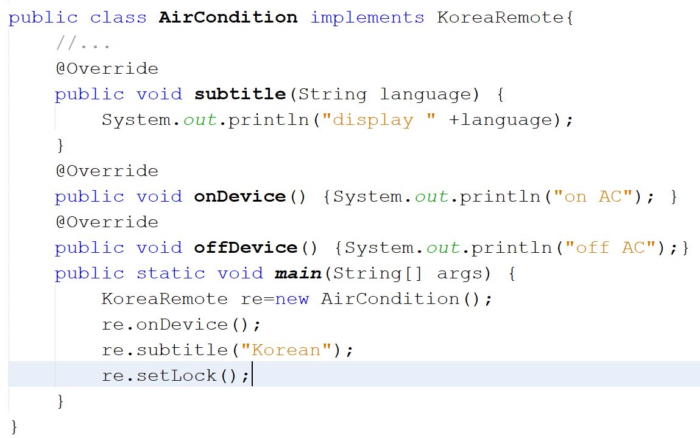
Example: how to extend interfaces
Output:
on AC
display Korean
set lock in the default method

Slide 18
Abstract Classes
Used to define what behaviors a class is required to perform without having to provide an explicit implementation.
It is the result of so-high generalization
Syntax to define a abstract class
public abstract class className{ ... }
It isn’t necessary for all of the methods in an abstract class to be abstract.
An abstract class can also declare implemented methods.

Slide 19
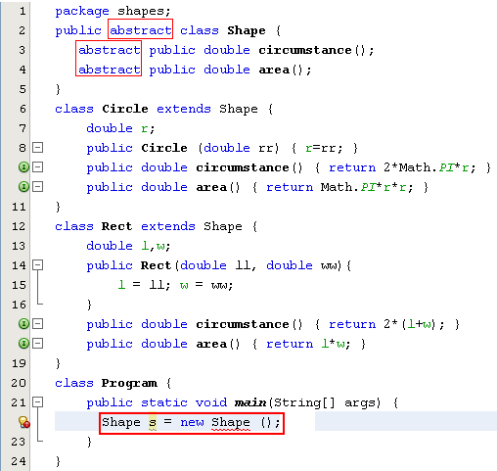
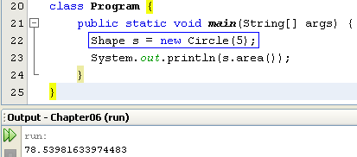
Abstract classes
Modified

Slide 20
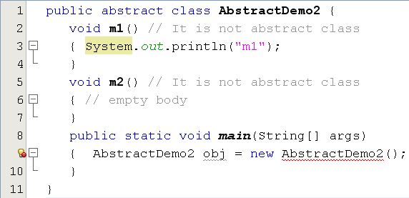
Abstract Classes
This class have no abstract method but it is declared as an abstract class. So, we can not initiate an object of this class.

Slide 21
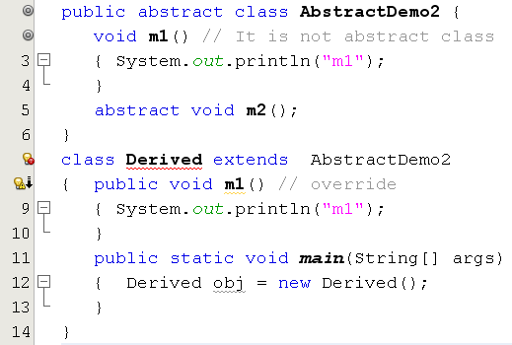
Abstract Classes…
Error. Why?

Slide 22
Implementing Abstract Methods
Derive a class from an abstract superclass, the subclass will inherit all of the superclass’s features, all of abstract methods included.
To replace an inherited abstract method with a concrete version, the subclass need merely override it.
Abstract classes cannot be instantiated

Slide 23
Nested Class(optional)
Why use nested class?
Types:
Local class
Anonymous class
…
Syntax of nested class
Examples
Reference:
Nested Classes (The Java™ Tutorials > Learning the Java Language > Classes and Objects) (oracle.com)
Anonymous Classes (The Java™ Tutorials > Learning the Java Language > Classes and Objects) (oracle.com)

Slide 24
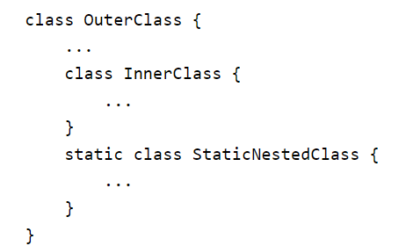
Why use nested class? (optional)
It is a way of logically grouping classes that are only used in one place: If a class is useful to only one other class, then it is logical to embed it in that class and keep the two together.
It increases encapsulation
It can lead to more readable and maintainable code: Nesting small classes within top-level classes places the code closer to where it is used.
Syntax:
Nested classes are divided into two categories: non-static(inner class/local class) and static.

Slide 25
Inner/local class(optional)
Local classes are classes that are defined in a block, which is a group of zero or more statements between balanced braces. You typically find local classes defined in the body of a method.
[demo]

Slide 26
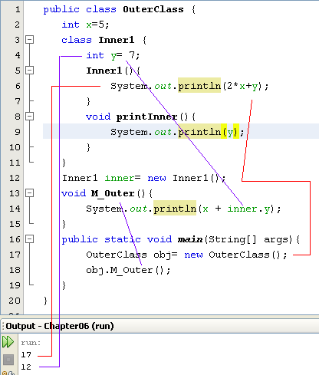
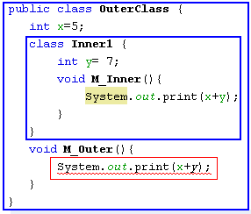
Inner class(optional)
outerObj
x=5
innerObj
y=7
y = 7
3000
A method of nested class can access all members of its enclosing class
obj
inner: 3000
x = 5
2000
obj: 2000
Error: inner obj do not created yet. Modified

Slide 27
Anonymous Classes(optional)
Anonymous classes are classes which are not named but they are identified automatically by Java compiler.
Where are they? They are identified at initializations of interface/abstract class object but abstract methods are implemented as attachments.
Why are they used?
Enable you to make your code more concise.
Enable you to declare and instantiate a class at the same time.
They are like local classes except that they do not have a name.
Use them if you need to use a local class only once.

Slide 28
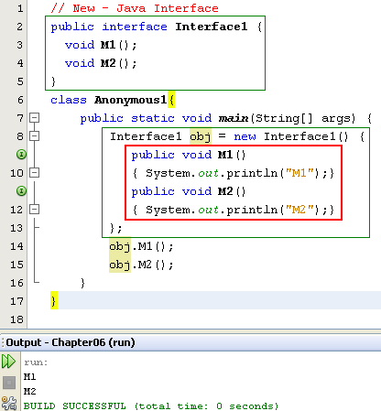

Anonymous Class(optional)
Anonymous class.
Class name is given by the compiler:
ContainerClass$Number

Slide 29
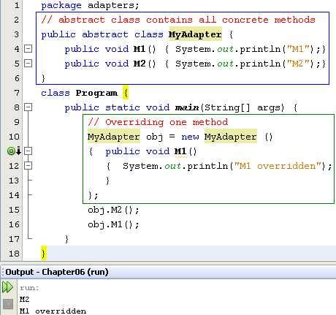
Anonymous Class…(optional)
Concrete methods but they can not be used because the class is declared as abstract one.
The abstract class can be used only when at least one of it’s methods is overridden
Anonymous class is a technique is commonly used to support programmer when only some methods are overridden only especially in event programming.

Slide 30
Summary
Polymorphism is a concept of object-oriented programming
Polymorphism is the ability of an object to take on many forms
Overloading and overriding are a technology to implement polymorphism feature.
In OOP occurs when a parent class/ interface reference is used to refer to a child class object

